Slide 1
XML Parser
Waqar Yar

Slide 2
Types of XML Parser
Dom Parser - Parses the document by loading the complete contents of the document and creating its complete hierarchical tree in memory.
SAX Parser - Parses the document on event based triggers. Does not load the complete document into the memory.
XPath Parser - Parses the XML based on expression and is used extensively in conjunction with XSLT.

Slide 3
DOM for XML.
The Document Object Model is an official recommendation of the World Wide Web Consortium (W3C). It defines an interface that enables programs to access and update the style, structure, and contents of XML do`cuments. XML parsers that support the DOM implement that interface.

Slide 4
When to use?
You should use a DOM parser when:
You need to know a lot about the structure of a document
You need to move parts of the document around (you might want to sort certain elements, for example)
You need to use the information in the document more than once

Slide 5
Advantages
When you parse an XML document with a DOM parser, you get back a tree structure that contains all of the elements of your document.
The DOM provides a variety of functions you can use to examine the contents and structure of the document.
The DOM is a common interface for manipulating document structures. One of its design goals is that Java code written for one DOM-compliant parser should run on any other DOM-compliant parser without changes

Slide 6
Common DOM methods
When you are working with the DOM, there are several methods you'll use often:
Document.getDocumentElement() - Returns the root element of the document.
Node.getFirstChild() - Returns the first child of a given Node.
Node.getLastChild() - Returns the last child of a given Node.
Node.getNextSibling() - These methods return the next sibling of a given Node.
Node.getPreviousSibling() - These methods return the previous sibling of a given Node.
Node.getAttribute(attrName) - For a given Node, returns the attribute with the requested name.

Slide 7
Steps to Using DOM
Following are the steps used while parsing a document using DOM Parser.
Import XML-related packages.
Create a DocumentBuilder
Create a Document from a file or stream
Extract the root element
Examine attributes
Examine sub-elements

Slide 8
Using DOM
Import XML-related packages
import org.w3c.dom.*; import javax.xml.parsers.*; import java.io.*;
Create a DocumentBuilder
DocumentBuilderFactory factory = DocumentBuilderFactory.newInstance(); DocumentBuilder builder = factory.newDocumentBuilder();

Slide 9
Using DOM
Create a Document from a file or stream
StringBuilder xmlStringBuilder = new StringBuilder(); xmlStringBuilder.append("<?xml version="1.0"?> <class> </class>");
ByteArrayInputStream input = new ByteArrayInputStream( xmlStringBuilder.toString().getBytes("UTF-8")); Document doc = builder.parse(input);
Extract the root element
Element root = doc.getDocumentElement();

Slide 10
Using DOM
Examine attributes
//returns specific attribute getAttribute("attributeName"); //returns a Map (table) of names/values getAttributes();
Examine sub-elements
//returns a list of subelements of specified name getElementsByTagName("subelementName"); //returns a list of all child nodes getChildNodes();

Slide 11
Java XPath Parser
The XPath is an official recommendation of the World Wide Web Consortium (W3C).
It defines a language to find information in an XML file. It is used to traverse elements and attributes of an XML document.
XPath provides various type of expressions which can be used to enquire relevant information from the XML document.

Slide 12
What is XPath?
Structure Definations - XPath defines the parts of an XML document like element, attribute, text, namespace, processing-instruction, comment, and document nodes
Path Expressions XPath provides powerful path expressions select nodes or list of nodes in XML documents.
Standard FunctionsXPath provides a rich library of standard functions for manipulation of string values, numeric values, date and time comparison, node and QName manipulation, sequence manipulation, Boolean values etc.
Major part of XSLTXPath is one of the major element in XSLT standard and is must have knowledge in order to work with XSLT documents.
W3C recommendationXPath is official recommendation of World Wide Web Consortium (W3C).

Slide 13
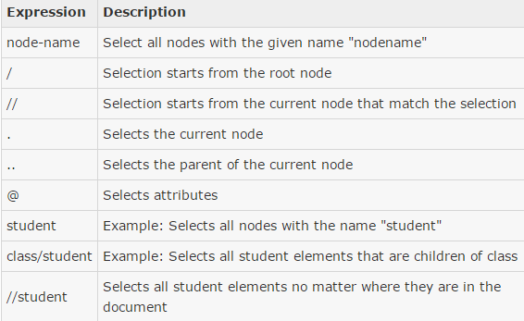
XPath Expressions
XPath uses a path expression to select node or list of nodes from an xml document.

Slide 14
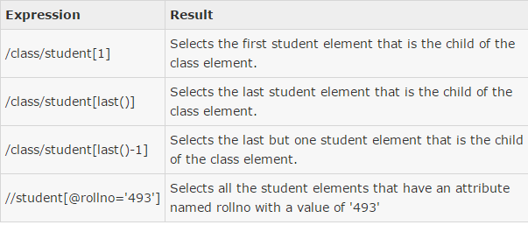
Predicates
Predicate are used to find specific node or a node containing specific value and are defined using [...]

Slide 15
Steps to Using XPath
Following are the steps used while parsing a document using XPath Parser.
Import XML-related packages.
Create a DocumentBuilder
Create a Document from a file or stream
Create an Xpath object and an XPath path expression
Compile the XPath expression using XPath.compile() and get a list of nodes by evaluating the compiled expression via XPath.evaluate()
Iterate over the list of nodes.
Examine attributes
Examine sub-elements

